Slide 1
Kinect for Windows v2 Sensor Features
Wider field of view (horizontally and vertically) for depth and color
3x depth fidelity
1080p, HD color camera (30fps)
Lighting independent IR (30 fps)
Improved microphones (zero balanced)
25 skeletal joints for six people -> Bio correct skeletal joints (particularly hips/shoulders/spine) plus more points and rotations
Thumb tracking, end of hand tracking, Open/Closed
Improved range -> .5M near, 4.5M far (extended depth to 8M)

Slide 2
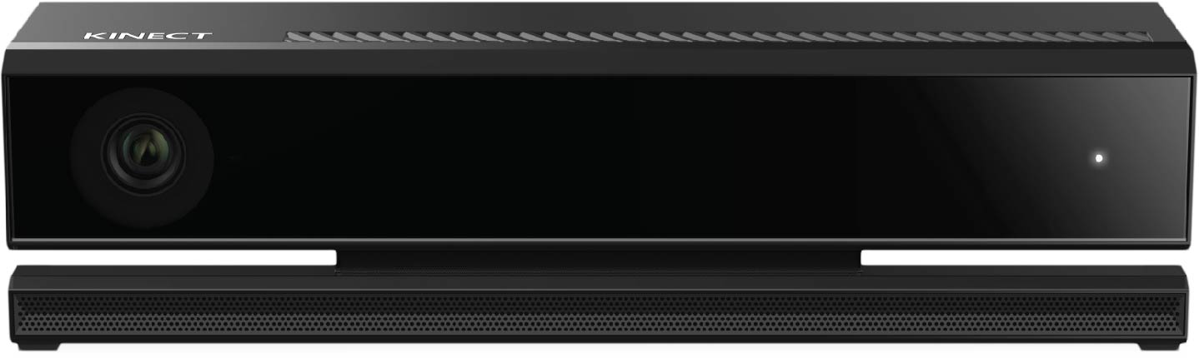
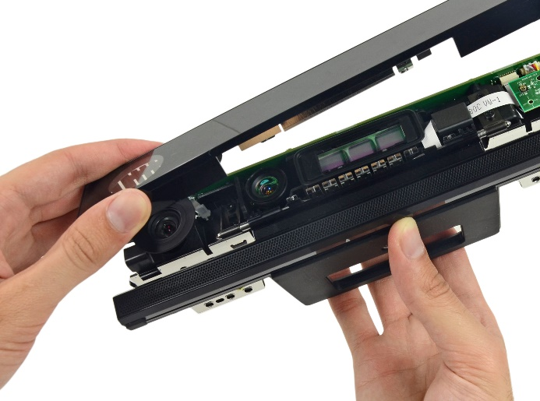
Sensor Components
Depth Sensor
Depth Sensor
IR Emitters
Power Light
IR Emitters
RGB Camera
Microphone Array
Image: iFixit, http://www.ifixit.com

Slide 3
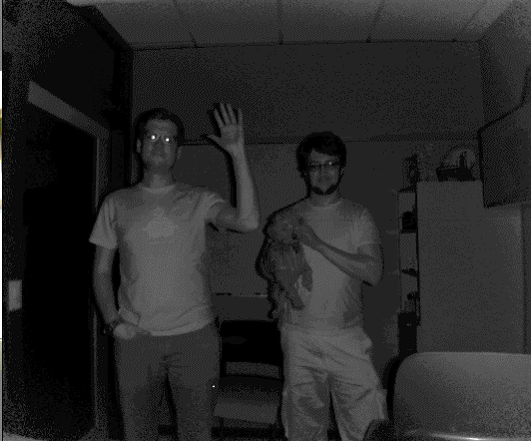
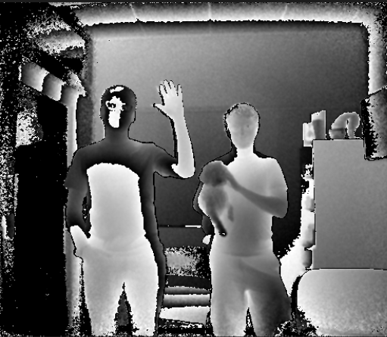
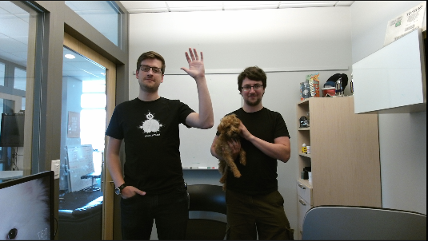
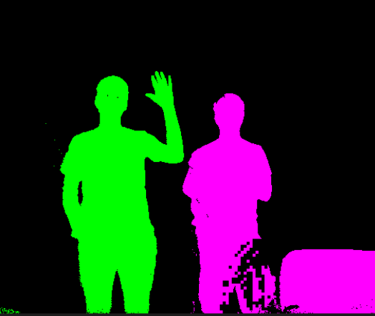
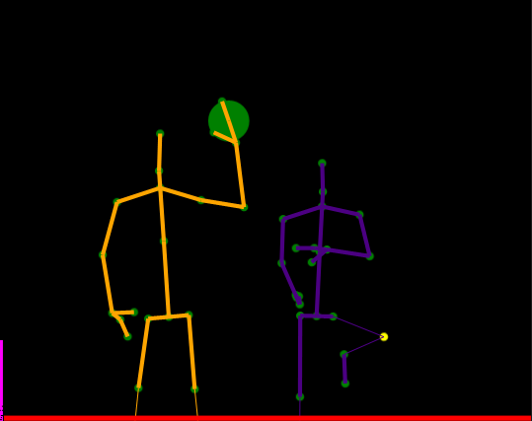
Kinect Data Sources
Infrared
Depth
Color
BodyIndex
Body
Audio
Notes:
Called “Streams” in V1

Slide 4
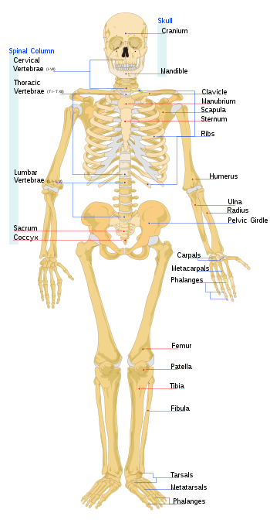
Body
Range is 0.5-4.5 meters
Frame data is a collection of Body objects each with 25 joints
Each joint has position in 3D space and an orientation
Up to six simultaneous bodies
30fps
Hand State on 2 bodies
Lean

Slide 5
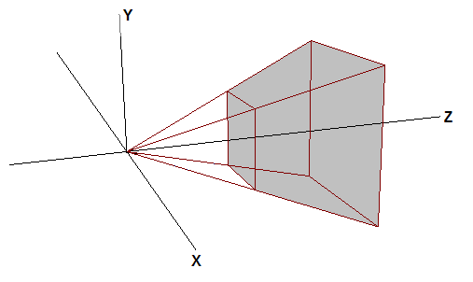
Coordinate mapping
Three coordinate systems
Coordinate mapper provides conversions between each system
Convert single or multiple points
Name | Applies to | Dimensions | Units | Range | Origin
ColorSpacePoint | Color | 2 | pixels | 1920x1080 | Top left corner
DepthSpacePoint | Depth, Infrared, Body index | 2 | pixels | 512x424 | Top left corner
CameraSpacePoint | Body | 3 | meters | – | Infrared/depth camera
Notes:
CameraSpacePoint was named SkeletonPoint in the V1 API. But it applies more generally, not only to Body joint positions, but to any point that is within the depth camera’s field of view. Hence, the new name.

Slide 6
关节点数据流
https://msdn.microsoft.com/query/dev12.query?appId=Dev12IDEF1&l=ZH-CN&k=k(Kinect%2FJoint);k(Joint);k(DevLang-C%2B%2B);k(TargetOS-Windows)&rd=true
关节点位置格式：CameraSpacePoint
https://msdn.microsoft.com/query/dev12.query?appId=Dev12IDEF1&l=ZH-CN&k=k(Kinect%2FCameraSpacePoint);k(CameraSpacePoint);k(DevLang-C%2B%2B);k(TargetOS-Windows)&rd=true
关节点类型：JointType
https://msdn.microsoft.com/en-us/library/microsoft.kinect.jointtype.aspx

